Slide 1


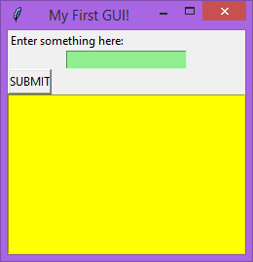
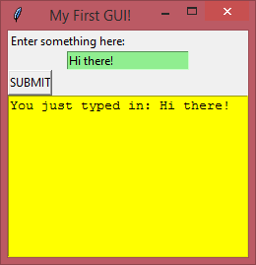
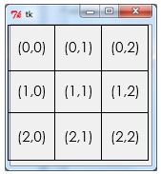
GUI Building with TKinter
Lesson 2 – Dictionaries & error handling

Slide 2


Activity 1
5mins
If you did Computer Science GCSE, you should be familiar with the dictionary data structure in Python. Try to find a Python program you wrote which included a dictionary to refresh your memory on what they are and how they work.
If you didn’t do Computer Science GCSE, use the internet to research what a dictionary in Python is and how they work.

Slide 3
Today’s lesson
So far we have created a simple GUI with buttons, entry boxes, text boxes and labels, and we have learnt how to add commands to buttons to call functions.
Today we are going to learn about the dictionary data type and see how we can apply this knowledge to create a simple glossary program.
Learning Objectives:
Understand what a dictionary data type is
Understand how to use a dictionary to create ‘glossary program’
Understand how to handle errors with dictionaries

Slide 4
Tkinter – using dictionaries
Dictionaries
Our glossary program will make use of a data structure known as a dictionary. A dictionary in python is a little bit like a list…
my_list = [“aardvark”, “abaca”, “aback”]
…but instead of each item being indexed e.g.:
‘Program’ is at index 0
(e.g. computing_words_list[0] = Program)),
…in a dictionary, each item has its own key and we can customise the key ourselves if we like.

Slide 5
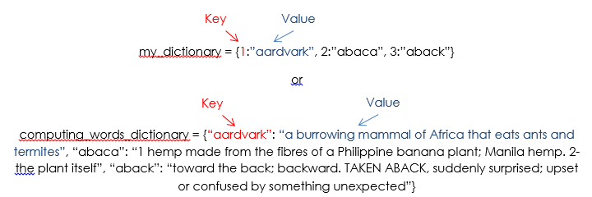
Tkinter – using dictionaries
Dictionary example
This means that we can use a dictionary to allow users to search for the meaning of a word which they type into our program. Our program can collect the word they enter and try to find a matching key in out dictionary, returning the appropriate value in the text box.

Slide 6
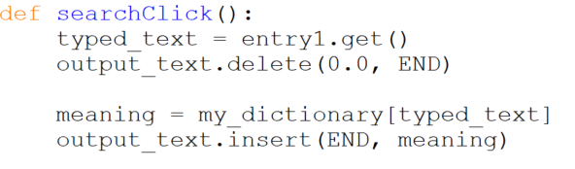
Tkinter – using dictionaries
Creating the dictionary
To create our dictionary we can add this code into the main section of our program (best to do it after the GUI building code, but before the mainloop()).
Next we can update our button_click function code.
The changes have simply been that we are using the typed_text variable as the dictionary key.
If the word they entered matches a key in our dictionary, then it will return the appropriate value. This returned value will be stored in a variable called ‘meaning’.
The variable ‘meaning’ is then inserted into the textbox like before.

Slide 7
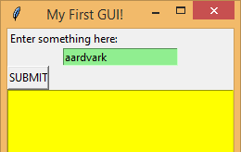
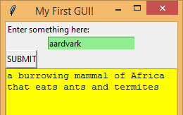
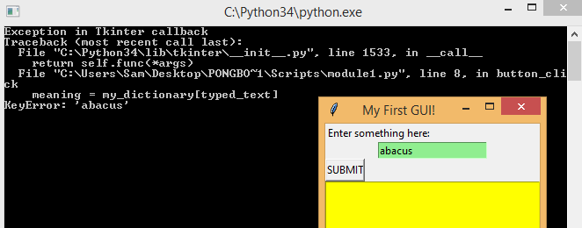
Tkinter – using dictionaries
Testing the Dictionary
The result is that if the user types in a word in our dictionary, the appropriate definition is displayed:
But if the user types in a word which is not in our dictionary, the program doesn’t crash but the console throws up an error:
Good programming involves thinking about all errors and handling them. Failing to do this will often cause bugs later down the line.

Slide 8
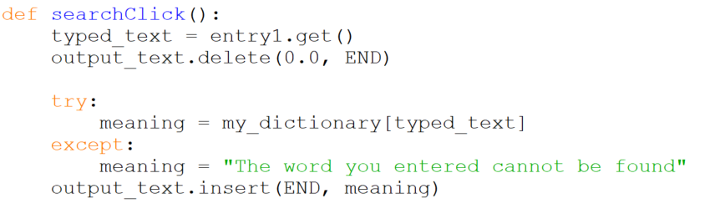
Tkinter – using dictionaries
Error Handling
Catching this error is easy; we can use a ‘try / except’ statement.
We can get the program to try to find the word in the dictionary; if it does it will assign the value found into the ‘meaning’ variable. If it fails to find it, it will handle the error and assign the string “The word you entered cannot be found” to the ‘meaning’ variable.

Slide 9

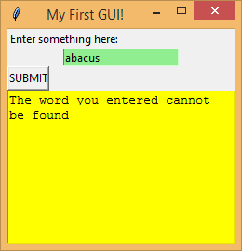
Tkinter – using dictionaries
The Result:

Slide 10
Activity 2
45mins
Create your own ‘Dictionary Program’ on a Computer Science theory topic of your choice – perhaps one that you are studying at the moment . Pick a number of keywords and definitions from that topic and make a dictionary containing these values. Then, allow the user to search for a keyword and output a definition if there is a matching key in the dictionary.
Use this tutorial as a guide, ask your teacher if you need help.
Save this work as “lesson 2 activity 2.py”

Slide 11
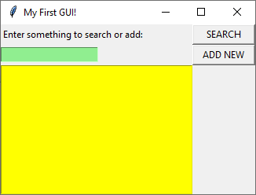
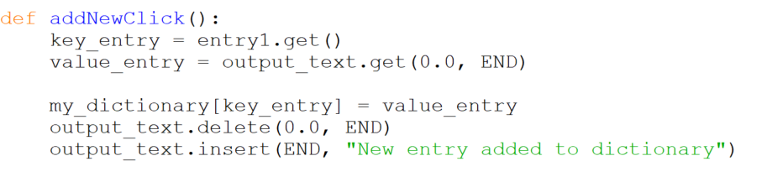
Tkinter – using dictionaries
New dictionary entries
Now that we have a dictionary we can search, we need to be able to add new entries.
Spend some time redesigning your window so that it now gives the user a choice between searching or adding a new item, like the one shown on the right.
The add new button then needs the following code attached to it:

Slide 12
Activity 3
Lesson and homework
Develop your Dictionary Program so that it has an extra couple of entry boxes and a new button so that the user can enter their own ‘words’ and ‘definitions’ into the dictionary.
Save this as “lesson 2 activity 3.py”
Extension: Develop your program so that it can save the dictionary so that when you close the program and open it, it isn’t lost. We will be covering this technique in future lessons, but if you can work out how to do it yourself it would give you a great head start!
There are a number of methods for saving and loading data from files. The two I recommend looking into are the simple file.write() and file.read() methods, or alternatively look up how to use the ‘pickle’ module.
Save this extension work as “lesson 2 extension”

Slide 13
Uploading your work
You should now have 2 complete Python files (plus any extension work). On Google classroom you will find an assignment for this lesson, and you need to upload your completed Python files to this assignment.
If you have any problems doing this, please speak to your teacher.

